Slide 1
6- String Methods

Slide 2
a few useful functions available to work with strings.
len() function is general purpose, so it's not limited to strings.
Later, I will show you how to use thisfunction with other kind of objects.
But in Python, we have quite a few functions that are specific to a strings.

Slide 3
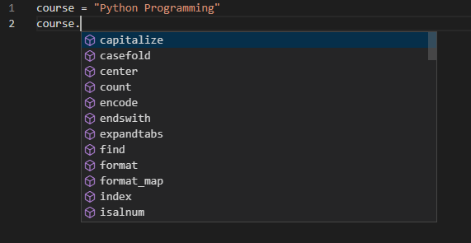
all these are functions available on strings.
Now in precise terms,we refer to these functions as methods. This is a term in object oriented programing that you will learnabout later in the course.

Slide 4
For now, what I want you to take away isthat everything in Python is an object
and objects have functions we call methodsthat we can access using the DOT notation.
So here course is an object. We use the DOT notation to access its functions or more accurately, methods.

Slide 5
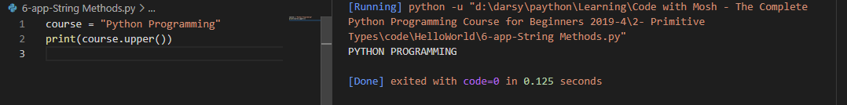
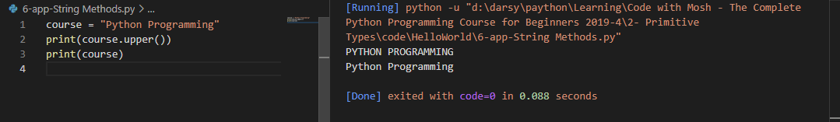
String.upper()
We have upper to convert a string to uppercase.
Now note that the methods that you call here return a new string. So the original string is not effected

Slide 6

So, course.upper returns a new string, a new value,

Slide 7
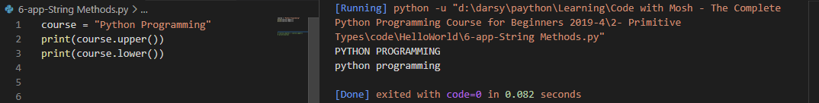
String.lower()
to convert a string to lowercase.

Slide 8
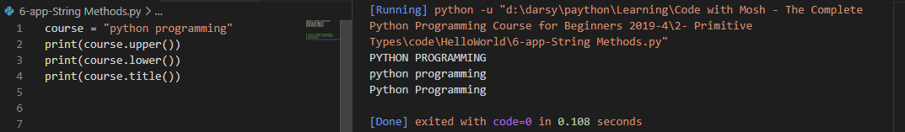
String.title()
We also have title which will capitalize the first letter of every word.

Slide 9
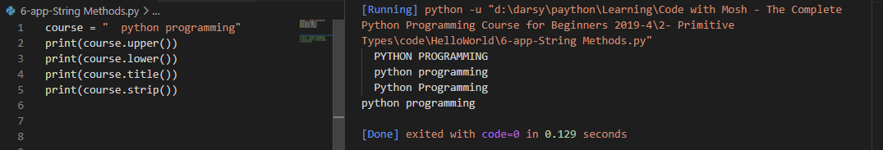
String.strip()
we use it to trim any white space atthe beginning or end of a string.
This is particularly useful whenwe receive input from the user.

Slide 10

String.lstrip() String.rstrip()
Lstrip, which is short for left strip and
rstrip, which is short or right strip. So it will remove the whitespace from the end of a string.

Slide 11
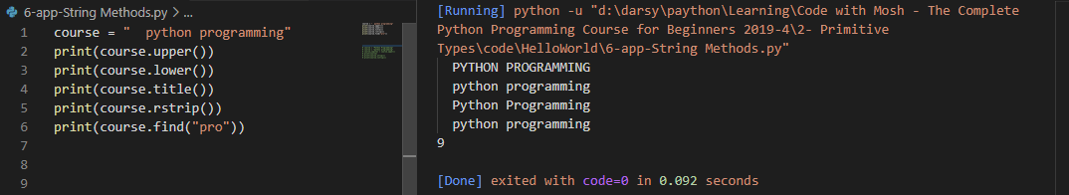
String.find(“smth”)
If you want to get the index of a character or a sequence of characters in your string, you should use the find method and.
as an argument here we pass another string, we can pass a characteror a series of characters.

Slide 12
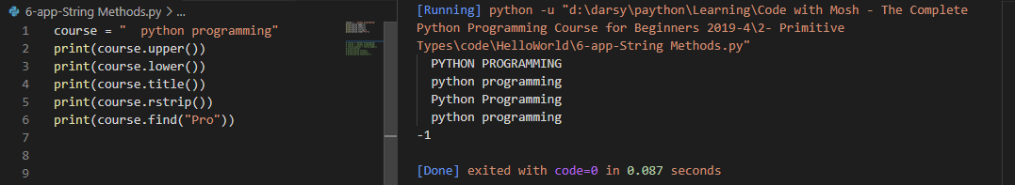
Python is a case sensitive language, so if I pass a capital P here,
obviously we don't have these exact characters in our string.
We get a negative one, that means this string was notfound in the original string.

Slide 13
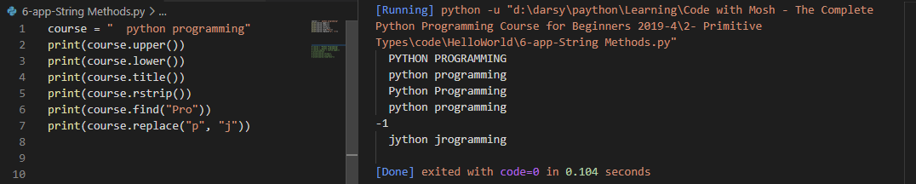
String.replace()
with this we can replace a character or a sequence of characters with something else.
So let's say we want to replaceall lowercase Ps with J.

Slide 14
if you want to check for the existence of a character or a sequence of characters in your string, you can use that in operator.
The bellow is an expression
"pro" in course
an expression isa piece of code that produces a value.
The difference between this expressionand calling the find method is that the fine method returns the indexof these characters in our stream. But as this expression returns, a boolean.

Slide 15
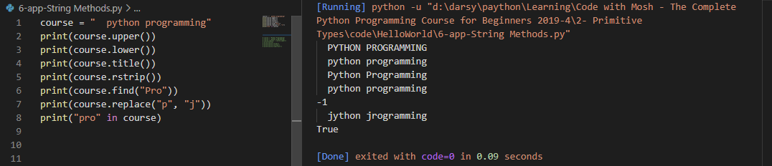

Slide 16
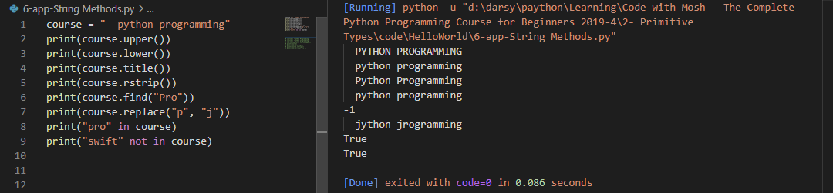
we use that to see if our string does not contain a character or sequence of characters, so.

